Slide 1
Vision-Based Driving Assistant System
Members:
1, Nguyen Quang Tuyen
2, Pham Dinh Ha
3, Pham Hoang

Slide 2
Introduction
Our system contains 3 models as follow:
Road Segmentation
Object Detection
Detect Drownsiness

Slide 3
Model I: Road Segmentation
1, Task
Semantic Segmentation, or image segmentation, is a task of clustering parts of the image together which belong to same object class. It is in form of pixel-level prediction
In this model, we have a smaller-scale of Semantic Segmentation problems, the model just only segment road
Input: A camera video from vehicles
Output: An output video with road segmentation

Slide 4
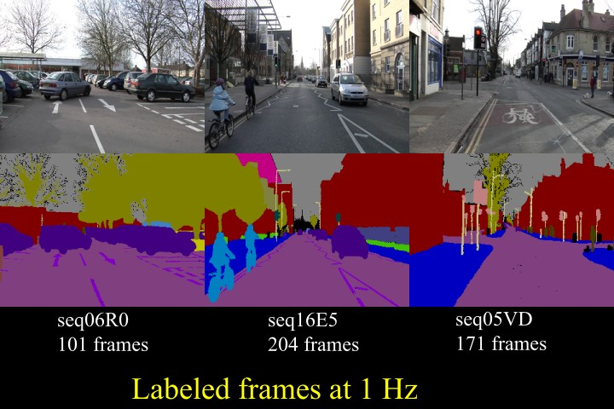
Model I: Road Segmentation
2: Data
The training Data is the CamVid dataset⁽¹⁾
Sample:
⁽¹⁾ http://mi.eng.cam.ac.uk/research/projects/VideoRec/CamVid/

Slide 5
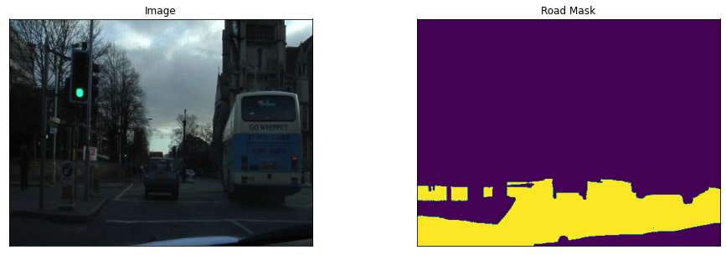
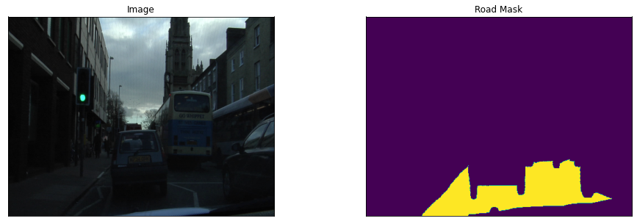
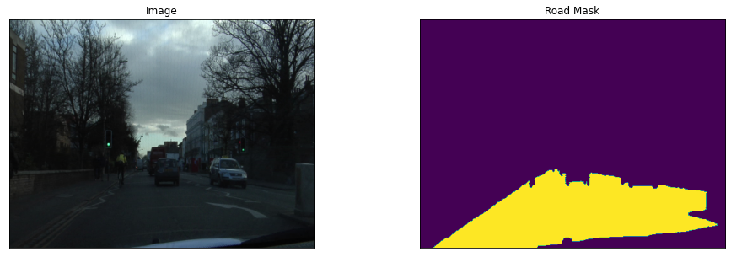
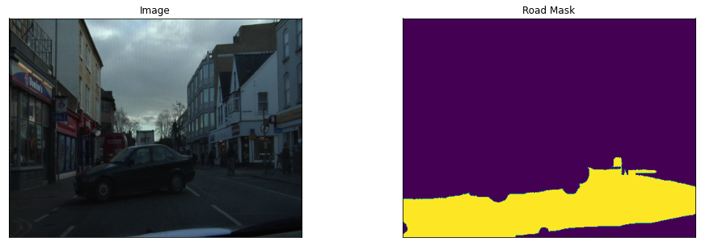
Model I: Road Segmentation
Preprocessed Data

Slide 6
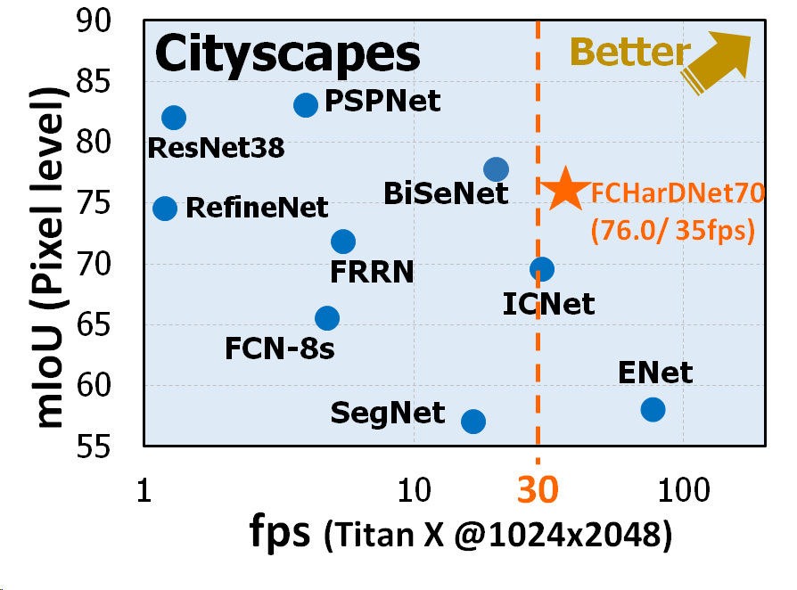
Model I: Road Segmentation
Paper: HarDNet, A low Memory Traffic Network (https://arxiv.org/pdf/1909.00948v1.pdf)
3. Model

Slide 7
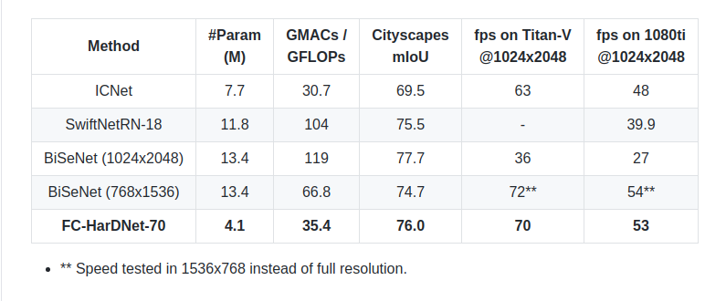
Model I: Road Segmentation
⇒ HarDNet minimize the computation cost without compromising the accuracy

Slide 8
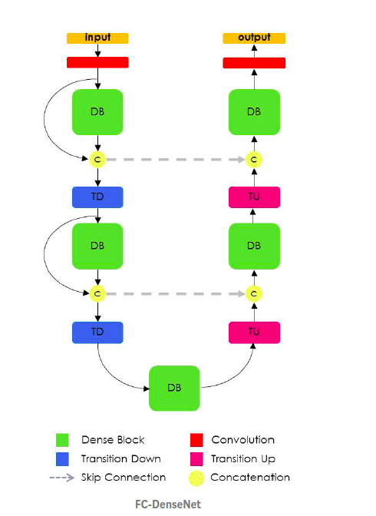
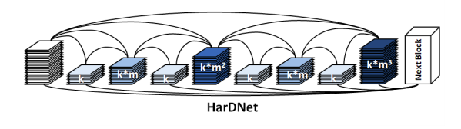
Model I: Road Segmentation
Architecture
+ Backbone architecture: DenseNet⁽²⁾
+In HarDNet Block We let layer k connect to layer k–2^{n} if 2^{n} divides k,where n is a non-negative integer and k–2^{n} ≥ 0; specifically, layer 0 is the input layer
+ Replace all DB in FCDenseNet by HDB
⁽²⁾ https://arxiv.org/abs/1608.06993
⁽¹⁾ Densely Connected Convolutional Networks: https://arxiv.org/pdf/1608.06993.pdf
Notes:
MACs: multiply-accumulate operations,
DRAM to write model parameters
Purpose of HarDNet is increasing computational efficiency, reduce MACs, less DRAM memory

Slide 9
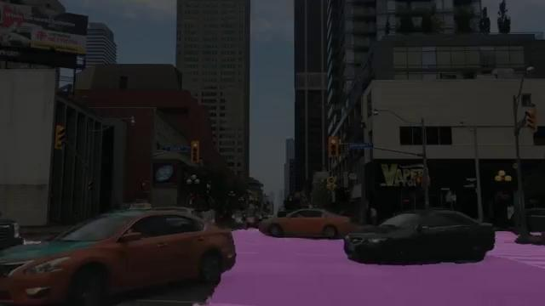
Model I: Road Segmentation
4, Result

Slide 10
Model I: Road Segmentation
5, Evaluation
While the output quite good, however, the fps value is high in range (0.3 to 0.8) in local without GPU
The previous video run in:

Slide 11
Model II: Traffic Object Detection
1, TASK NAME
Object Detection is the task of detection instances of a class in an image.
This model purpose is to classify object in traffic with name and bounding - box
Improve efficiency of neural network architecture for object detection
Input: An image (Frames from video)
Output: An output image with bounding box (combine to output video)

Slide 12
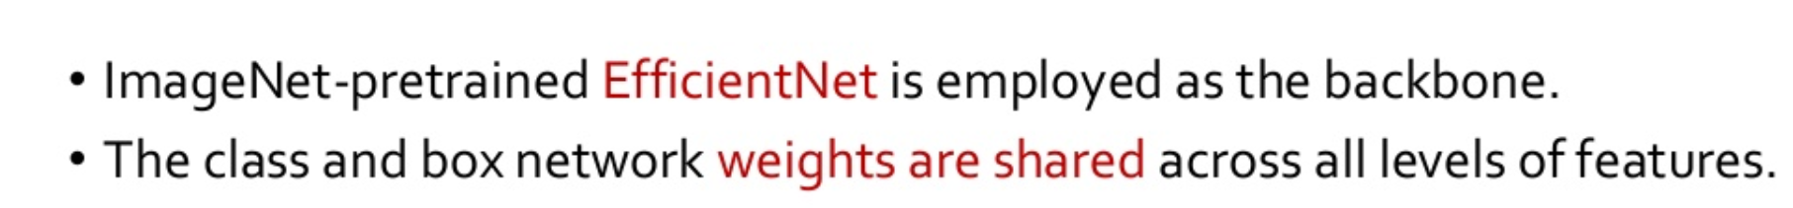
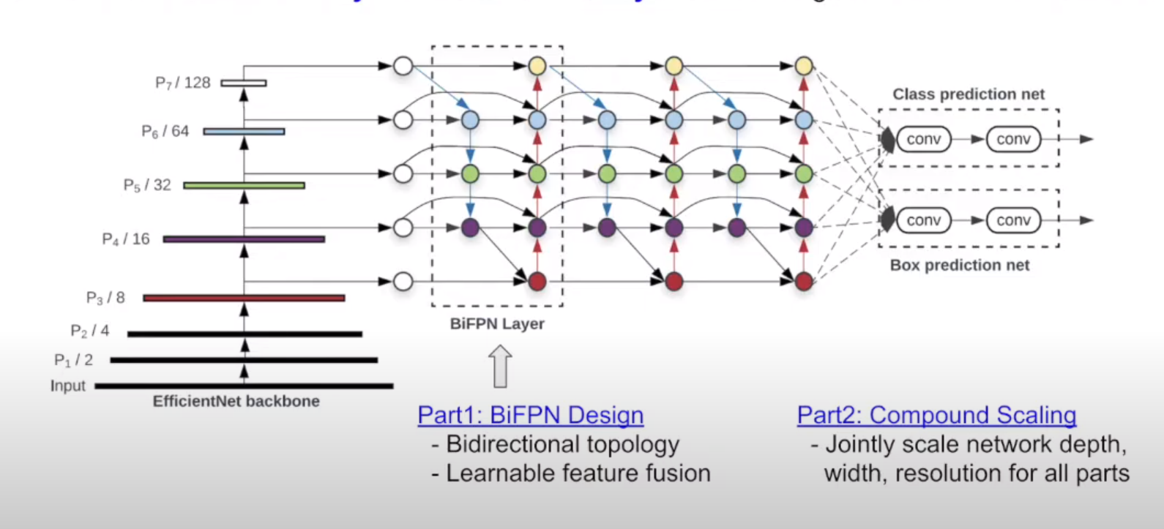
Model II: Object Detection
2, MODEL: EfficientDet⁽¹) Scalable and Efficient Object Detection
⁽¹⁾https://arxiv.org/pdf/1911.09070.pdf

Slide 13
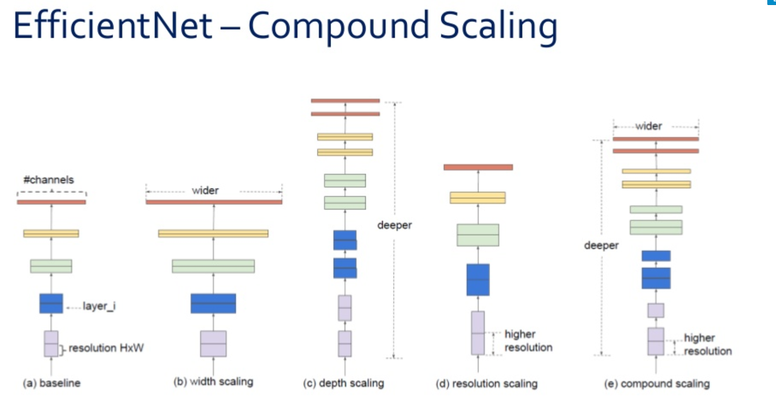
Model II: Object Detection
2, MODEL: EfficientDet⁽¹⁾ Scalable and Efficient Object Detection
⁽¹⁾https://arxiv.org/pdf/1911.09070.pdf

Slide 14
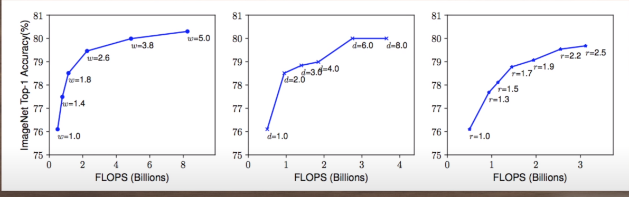
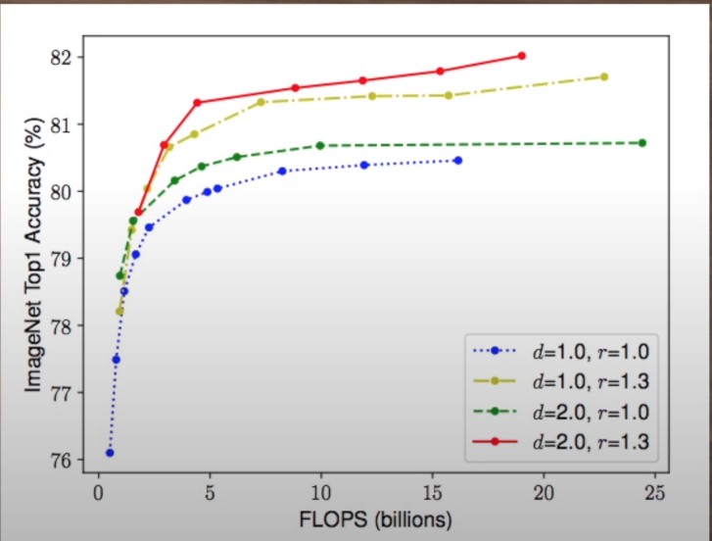
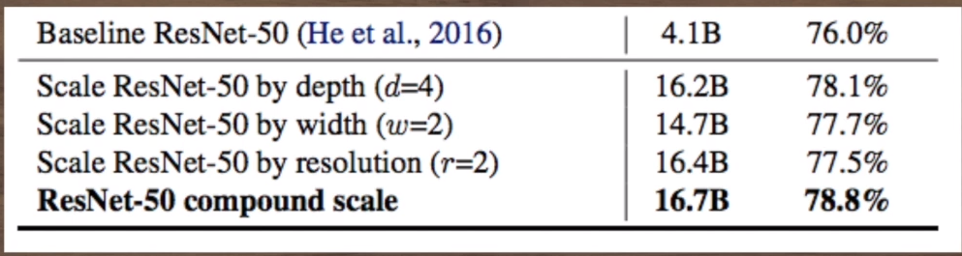
Model II: Object Detection
2, MODEL: EfficientDet⁽¹⁾ Scalable and Efficient Object Detection
2, MODEL: EfficientDet⁽¹⁾ Scalable and Efficient Object Detection
⁽¹⁾https://arxiv.org/pdf/1911.09070.pdf

Slide 15
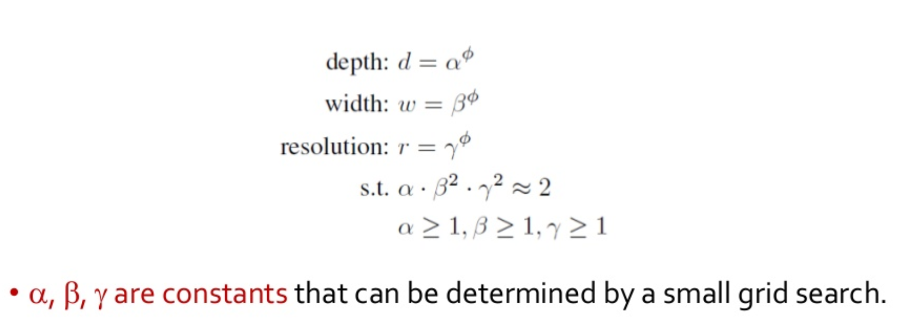
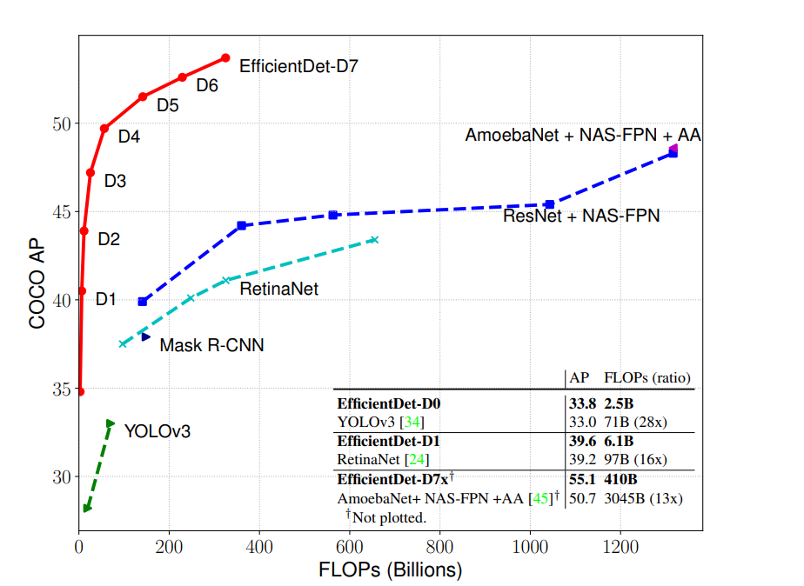
Model II: Object Detection
2, MODEL: EfficientDet⁽¹⁾ Scalable and Efficient Object Detection
⁽¹⁾https://arxiv.org/pdf/1911.09070.pdf

Slide 16
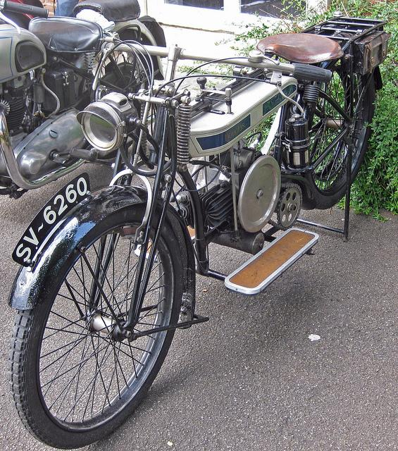
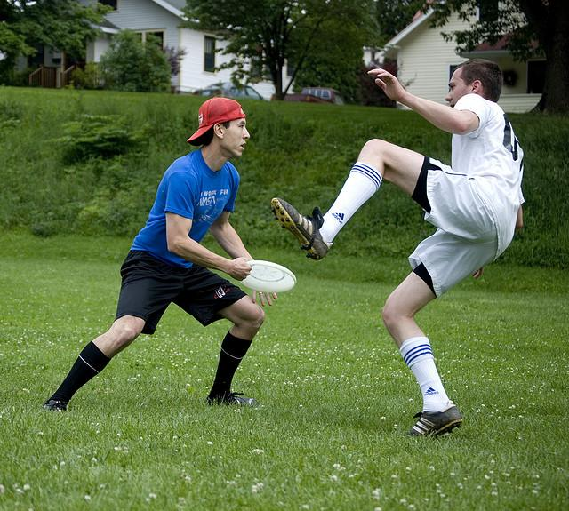
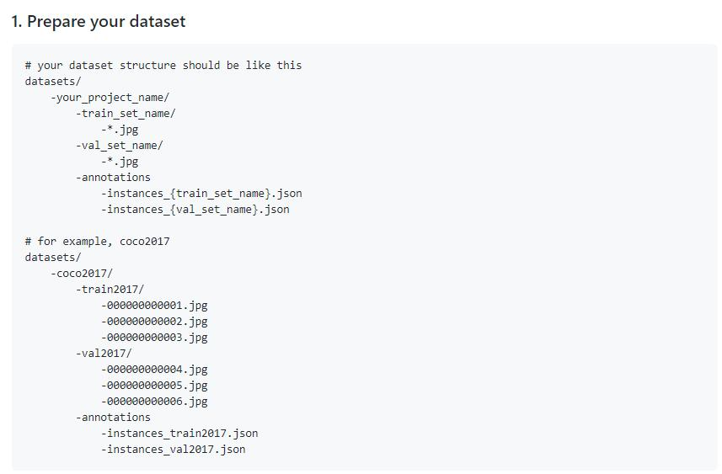
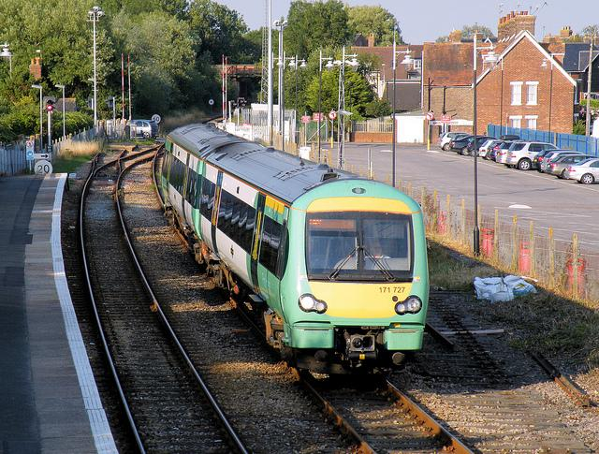
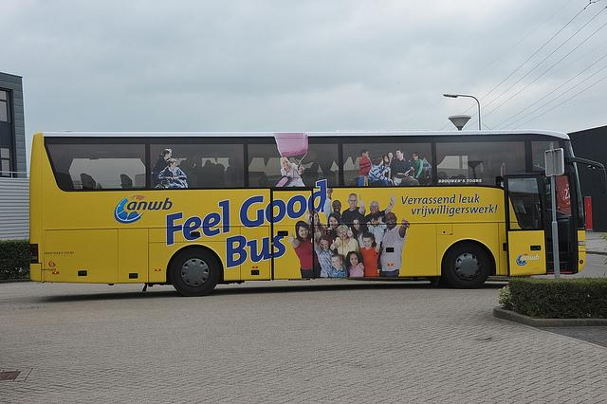
Model II: Object Detection
3, FINE-TUNE MODEL
Pretrain model EfficientDet D2
The training data is Coco2017

Slide 17
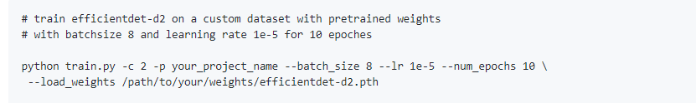
Model II: Object Detection
4, TRAIN MODEL
The training data is Coco-2017
Training data: 73600 pics
Test data: 3100 pics

Slide 18

Model II: Object Detection
5: OUTPUT VIDEO

Slide 19
Model II: Object Detection
4: WEB DEMO

Slide 20
Model II: Object Detection
5, EVALUATION
The fps value is high in range (7.0 to 8.0) in local with GPU
Cannot real-time
Lower accuracy
6, ORIENTATION
Counting the vehicles
Determine Object Distance
Traffic light (red-green-yellow)

Slide 21
Model III: Detecting Drownsiness
1, Task
Detect when a driver is falling asleep, and alarm the driver and passengers of the situation so that appropriate measures can be taken.
Input: image sequences from camera
Output: Driver is drowsy or awake

Slide 22
Model III: Dectecting Drownsiness
Dataset: The University of Texas at Arlington Real-Life Drowsiness Dataset (UAT-RLDD)
Self-recorded videos from 60 healthy participant. Each participant recorded three videos representing three alertness classes labeled by the participant
Alert: Completely conscious and able to drive for long hours
Low Vigilant: some signs of sleepiness
Drowsy: Actively try not to fall asleep

Slide 23
Model III: Detecting Drownsiness
Data preprocessing:
Choose 15videos from the dataset: 8 alert + 7 drowsy
Cut the video so that it only contain the exact alert or drowsy part
Using face detection to extract face region from 1000 frames of each video
Training: 9000 pics
Testing: 6000 pics

Slide 24
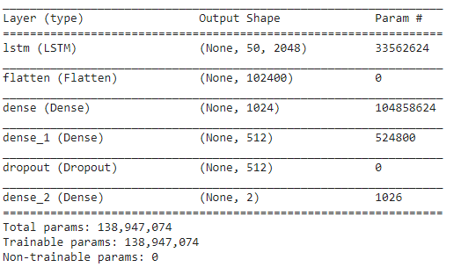
Model III: Detecting Drownsiness
Model: CNN - LSTM
Extract faces from each frame using OpenCV Deeplearning face detector
Extract significant visual features from the images using Inception V3
Feed the extracted features into LSTM.

Slide 25
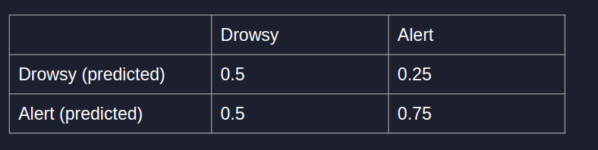
Model III: Detecting Drownsiness
Testing accuracy: 66.7%
Evaluation:
Precision = 0.5
Recall = 0.75

Slide 26
Model III: Dectecting Drownsiness
Conclusion:
Low accuracy due to small training and testing dataset
Need to train the model on more data to achieve higher accuracy.
Training videos have to be in the exact part

